Slide 1
CSDS 451: Designing High Performant Systems for AI
Lecture 23
11/20/2025
Sanmukh Kuppannagari
sanmukh.kuppannagari@case.edu
https://sanmukh.research.st/
Case Western Reserve University

Slide 2
Outline
Data Parallel Distributed Training
Model Parallel Distributed Training

Slide 3
Announcements
WA 4 was out
Due December 4
Finals next Tuesday
Transformer Models
Clusters
How to program clusters with MPI
Communication collectives with complexity
Distributed training – very simple question to check knowledge, no application/analysis questions

Slide 4
Midterm Logistics
60 minute exam, on paper
15~20 Fill in the blank/True-False questions
With space for explanation
1 point for answer
2 for explanation - wrong answer with a reasonable explanation will receive partial credits
2 big questions

Slide 5
Midterm Logistics
Open Notes
You can use slides
I suggest you create a cheat sheet: You won’t have enough time to search for concepts.
No questions during exam (Gets too distractive)
If a questions is ambiguous, write your assumption and solve
The assumption will be taken into consideration when grading
You should not need a calculator
You can use your phone if you do need it

Slide 6
Midterm Logistics
Exam may be lengthy (intentionally)
If you know the concepts well, you should be able to solve in time
Searching your notes or slides will incur additional time
Plan the questions you want to solve first accordingly
Suggestion: Get the big questions out of the way.
Don’t get stuck on a question. If you can’t solve go ahead and come back
If you don’t know an answer, write your explanation. We will consider that while grading

Slide 7
Outline
Data Parallel Distributed Training
Model Parallel Distributed Training

Slide 8
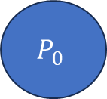
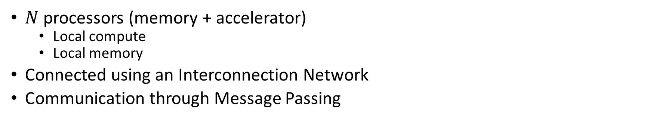
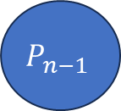
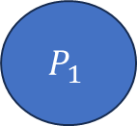
Cluster of Accelerators
$N$ processors (memory + accelerator)
Local compute
Local memory
Connected using an Interconnection Network
Communication through Message Passing
Interconnection Network
$$P_{0}$$
$$P_{1}$$
$$P_{n−1}$$
…

Slide 9
Anatomy of an MPI Program
MPI_Init(…)
MPI_Comm_rank(MPI_COMM_WORLD, &my_rank)
MPI_Comm_size(MPI_COMM_WORLD, &num_procs);
Do rank specific work

Slide 10
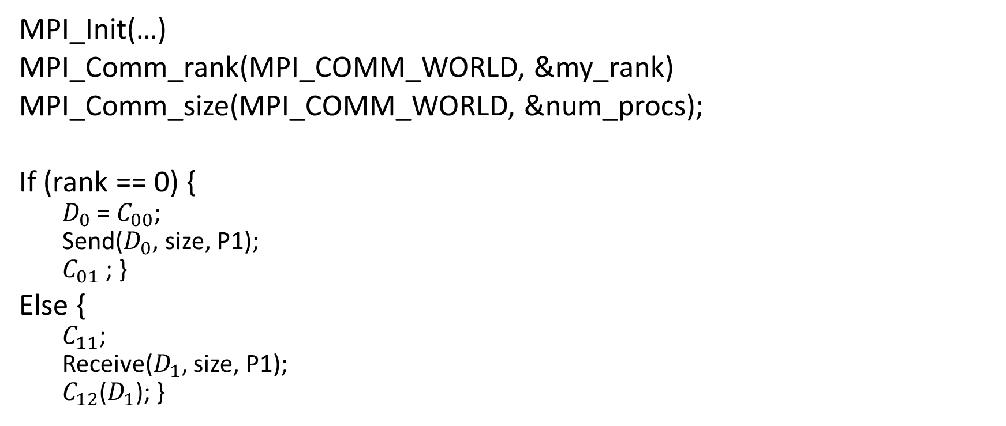
Inter-Process Communication
MPI_Init(…)
MPI_Comm_rank(MPI_COMM_WORLD, &my_rank)
MPI_Comm_size(MPI_COMM_WORLD, &num_procs);
If (rank == 0) {
$D_{0}$ = $C_{00}$;
Send($D_{0}$, size, P1);
$C_{01}$ ; }
Else {
$C_{11}$;
Receive($D_{1}$, size, P1);
$C_{12}$($D_{1}$); }
Rank 0
Rank 1
Data local to program₀
Data local to program₁
Two processor world

Slide 11
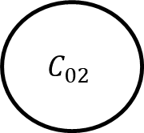
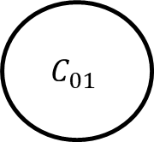
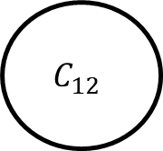
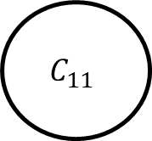
Inter-Process Communication
P0
P1
$$C_{01}$$
$$C_{11}$$
$$C_{02}$$
$$C_{12}$$
Dependency across processors due to communication operation

Slide 12
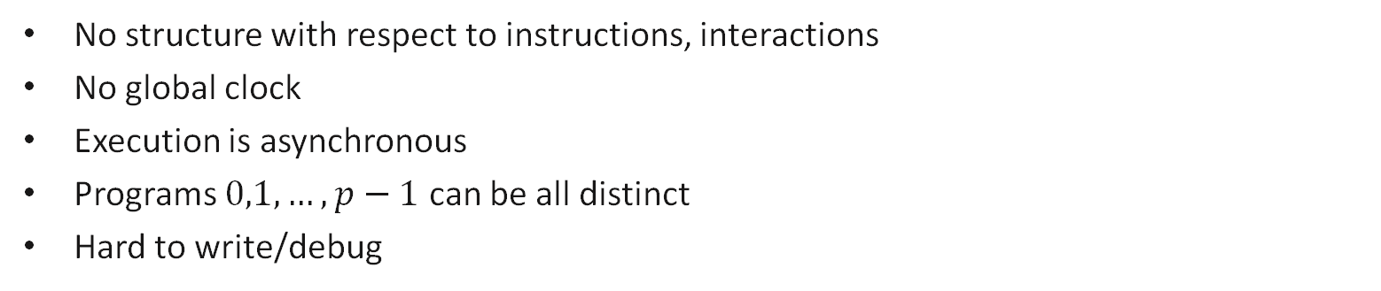
Message Passing Program
Most General Model: Asynchronous
Program₀
Program₁
Program₂
S
S
R
……
R
R
S
R
S = send
R = receive
S
End
End
End
No structure with respect to instructions, interactions
No global clock
Execution is asynchronous
Programs $0,1,…, p−1$ can be all distinct
Hard to write/debug

Slide 13
Message Passing Program
Bulk synchronous
Program₀
Program₁
Program₂
Program₃
Program₄
Computation phase
Communication phase
sync
Two phases to the Program
Computation Phase: Each process executes independently. No communication
Communication Phase: Processes communicate with each other

Slide 14
Message Passing Program
SPMD (Single Program Multiple Data)
Code is same in all the processes except for initialization
Restrictive model, easy to write and debug
Easy to do performance analysis
Widely used in Machine Learning Training
Program₀
Program₁
Program₂
Program₃
Program₄
Program₄

Slide 15
Blocking Non-Buffered Send/Receive
Sending
process
Receiving
process
Sending
process
Receiving
process
Sending
process
Receiving
process
Request
to send
Request
to send
Send
Request
to send
Idle
okay
to send
Send
Idle
okay
Recv.
Recv.
data
Send
okay
Recv.
data
data
Sender comes first;
idling at sender
(b) Sender and Receiver come at about the same time;
idling minimized
(c) Receiver comes first;
idling at Receiver

Slide 16


Virtual Topology
Define the “connectivity pattern” of the processors
Helps us in developing more intuitive notions of message passing algorithms
Think of it as 1D versus 2D arrays. It will be hard to visualize matrix multiplication if we write algorithms using 1D arrays
$$0 1 p−1$$
…
…
$$0 1 p−1$$
…
1D Mesh
…
2D Mesh

Slide 17
Message Passing Programming Paradigm
User Specifies the following
Concurrency Model (BSP, SPMD, None/Asynchronous)
Processes: The number of processes and the work performed for each process
Send, receive that enable data (we will only use blocking non-buffered semantics)
A virtual topology of the processes
We will discuss it at algorithmic level.
Skip initialization, rank calculation, etc.

Slide 18
MPI_Broadcast
MPI_Broadcast(buffer, size, root)
Send the data stored in buffer at the root processor to all the processors
Notes:
Image source: https://fs.hlrs.de/projects/par/par_prog_ws/pdf/mpi_3.1_rab.pdf

Slide 19
MPI_Scatter

Slide 20
MPI_Gather

Slide 21
MPI_Reduce

Slide 22
MPI_AllReduce
MPI_AllReduce(inbuf, resultbuf, size)
Same as MPI_Reduce() but stores the results in all the processors
Equivalent to:
MPI_Reduce(inbuf, ibsize, resultbuf, rbsize, Aggr_op, root)
MPI_Broadcast(resultbuf, rbsize, root )

Slide 23
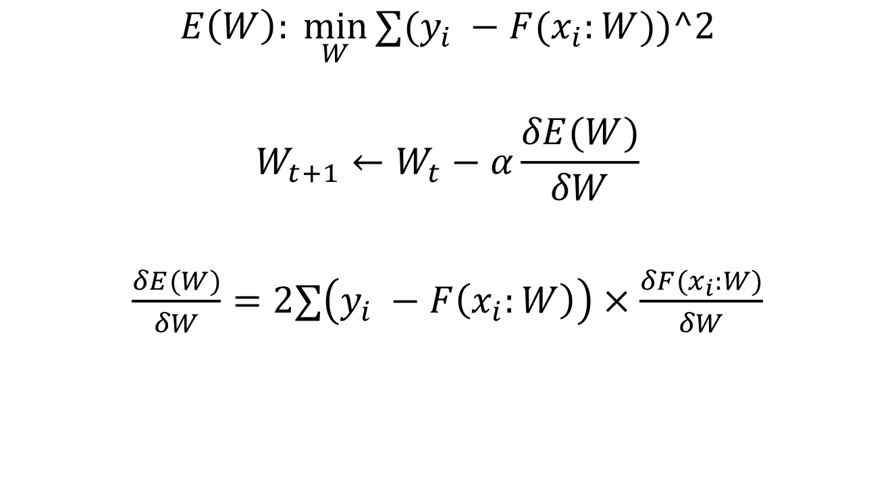
Training
$$E\left(W\right): \min_{W}{∑(y_{i} −{F(x}_{i}:W))^2}$$
$$W_{t+1}←W_{t}−α\frac{δE(W)}{δW}$$
$\frac{δE(W)}{δW}=2∑\left(y_{i} −F\left(x_{i}:W\right)\right)×\frac{δF(x_{i}:W)}{δW}$
Iteratively
For all samples, in each iteration
Error

Slide 24
Training
$L$ layers in CNN
$$W_{1}, W_{2}, W_{3}, …, W_{L}$$
$$O_{1}, O_{2}, O_{3}, …, O_{L}$$
$$\frac{δF(x_{i}:W_{1:L})}{δW_{1}},\frac{δF(x_{i}:W_{1:L})}{δW_{2}},…,\frac{δF(x_{i}:W_{1:L})}{δW_{L}}$$
Weights (Filters/Kernels)
Output of layer
$$2∗Error ∗$$

Slide 25

CNN Training: Forward Propagation
$$I$$
For a single image

Slide 26


CNN Training: Forward Propagation
$$I$$
$$W_{1}$$
$$O_{1}$$
For a single image

Slide 27


CNN Training: Forward Propagation
$$I$$
$$W_{1}$$
$$O_{1}$$
$$W_{2}$$
$$O_{2}$$
For a single image

Slide 28


CNN Training: Forward Propagation
$$I$$
$$W_{1}$$
$$O_{1}$$
$$W_{2}$$
$$O_{2}$$
…
$$W_{L}$$
$$O_{L}$$
For a single image

Slide 29


CNN Training: Error Calculation
$$O_{L}$$
$$E(W)$$
$$y$$
For a single image

Slide 30
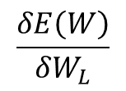
CNN Training: Backward Propagation
$$W_{L}$$
$$O_{L}$$
$$E(W)$$
$$y$$
$$\frac{δE\left(W\right)}{δW_{L}}$$
For a single image

Slide 31
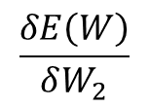
CNN Training: Backward Propagation
$$W_{2}$$
$$O_{2}$$
…
$$W_{L}$$
$$O_{L}$$
$$E(W)$$
$$y$$
$$\frac{δE\left(W\right)}{δW_{2}}$$
$$\frac{δE\left(W\right)}{δW_{L}}$$
For a single image

Slide 32
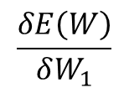
CNN Training: Backward Propagation
$$W_{1}$$
$$O_{1}$$
$$W_{2}$$
$$O_{2}$$
…
$$W_{L}$$
$$O_{L}$$
$$E(W)$$
$$y$$
$$\frac{δE\left(W\right)}{δW_{1}}$$
$$\frac{δE\left(W\right)}{δW_{2}}$$
$$\frac{δE\left(W\right)}{δW_{L}}$$
For a single image

Slide 33



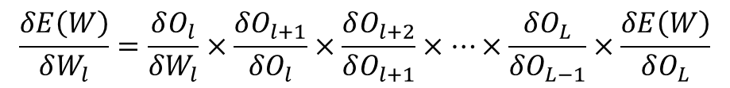

CNN Training: Backward Propagation
$$W_{l}$$
$$O_{l}$$
$$W_{l+1}$$
$$O_{l+1}$$
…
$$W_{L}$$
$$O_{L}$$
$$E(W)$$
$$y$$
$$\frac{δE\left(W\right)}{δW_{l}}=\frac{δO_{l}}{δW_{l}}×\frac{δO_{l+1}}{δO_{l}}×\frac{δO_{l+2}}{δO_{l+1}}×…×\frac{δO_{L}}{δO_{L−1}}×\frac{δE\left(W\right)}{δO_{L}}$$
For a single image

Slide 34
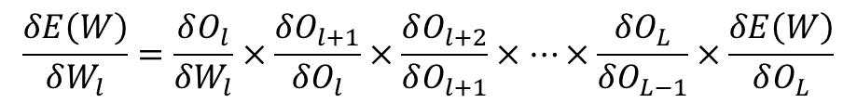
Training
$$E\left(W\right): \min_{W}{∑(y_{i} −{F(x}_{i}:W))^2}$$
$$W_{t+1}←W_{t}−α\frac{δE(W)}{δW}$$
$\frac{δE(W)}{δW}=2∑\left(y_{i} −F\left(x_{i}:W\right)\right)×\frac{δF(x_{i}:W)}{δW}$
Iteratively
For all samples, in each iteration
Error
For multiple images in a batch: Simply sum up the gradients
$$\frac{δE\left(W\right)}{δW_{l}}=\frac{δO_{l}}{δW_{l}}×\frac{δO_{l+1}}{δO_{l}}×\frac{δO_{l+2}}{δO_{l+1}}×…×\frac{δO_{L}}{δO_{L−1}}×\frac{δE\left(W\right)}{δO_{L}}$$

Slide 35

Gradient Update
$$W←W −α\frac{δE\left(W\right)}{δW}$$
Lets dig deeper into Gradient Update

Slide 36

Gradient Update
For a mini-batch with $M$ samples and mean squared error
$E\left(W\right)= \sum_{i=1}^{M}{E_{i}(W)}$
$E_{i}\left(w\right)={\left(O_{Li} −y_{i}\right)}^{2}$
$\frac{δE\left(W\right)}{δW}=\sum_{i=1}^{M}{\frac{δE_{i}\left(W\right)}{δW}}$

Slide 37
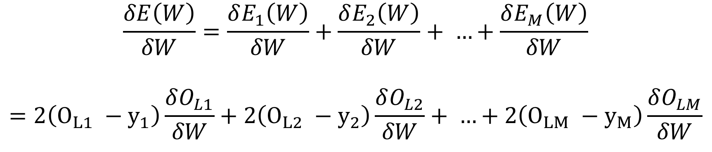
Gradient Update
$$\frac{δE\left(W\right)}{δW}=\frac{δE_{1}\left(W\right)}{δW}+\frac{δE_{2}\left(W\right)}{δW}+ …+\frac{δE_{M}\left(W\right)}{δW}$$
$$=2\left(O_{L1} −y_{1}\right)\frac{δO_{L1}}{δW}+2\left(O_{L2} −y_{2}\right)\frac{δO_{L2}}{δW}+ …+2\left(O_{LM} −y_{M}\right)\frac{δO_{LM}}{δW}$$
Can be calculated in parallel

Slide 38
Gradient Update
$$\frac{δE\left(W\right)}{δW}=\frac{δE_{1}\left(W\right)}{δW}+\frac{δE_{2}\left(W\right)}{δW}+ …+\frac{δE_{M}\left(W\right)}{δW}$$
$$=2\left(O_{L1} −y_{1}\right)\frac{δO_{L1}}{δW}+2\left(O_{L2} −y_{2}\right)\frac{δO_{L2}}{δW}+ …+2\left(O_{LM} −y_{M}\right)\frac{δO_{LM}}{δW}$$
Forward propagation in parallel – Need multiple copies of model

Slide 39
Gradient Update
$$\frac{δE\left(W\right)}{δW}=\frac{δE_{1}\left(W\right)}{δW}+\frac{δE_{2}\left(W\right)}{δW}+ …+\frac{δE_{M}\left(W\right)}{δW}$$
$$=2\left(O_{L1} −y_{1}\right)\frac{δO_{L1}}{δW}+2\left(O_{L2} −y_{2}\right)\frac{δO_{L2}}{δW}+ …+2\left(O_{LM} −y_{M}\right)\frac{δO_{LM}}{δW}$$
Error Calculation in parallel

Slide 40
Gradient Update
$$\frac{δE\left(W\right)}{δW}=\frac{δE_{1}\left(W\right)}{δW}+\frac{δE_{2}\left(W\right)}{δW}+ …+\frac{δE_{M}\left(W\right)}{δW}$$
$$=2\left(O_{L1} −y_{1}\right)\frac{δO_{L1}}{δW}+2\left(O_{L2} −y_{2}\right)\frac{δO_{L2}}{δW}+ …+2\left(O_{LM} −y_{M}\right)\frac{δO_{LM}}{δW}$$
Backward Propagation in parallel

Slide 41
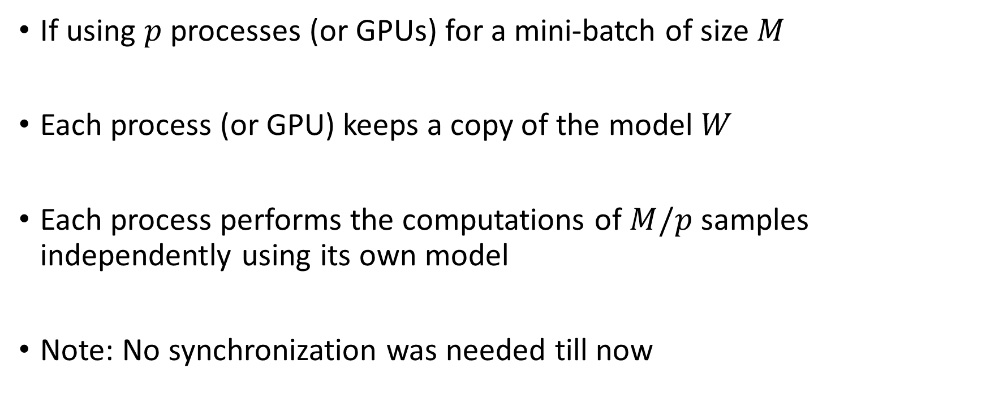
Gradient Update
If using $p$ processes (or GPUs) for a mini-batch of size $M$
Each process (or GPU) keeps a copy of the model $W$
Each process performs the computations of $M/p$ samples independently using its own model
Note: No synchronization was needed till now

Slide 42

Gradient Update
Weight Update Step:
$$W←W −α\frac{δE\left(W\right)}{δW}$$
Do we need synchronization now???

Slide 43
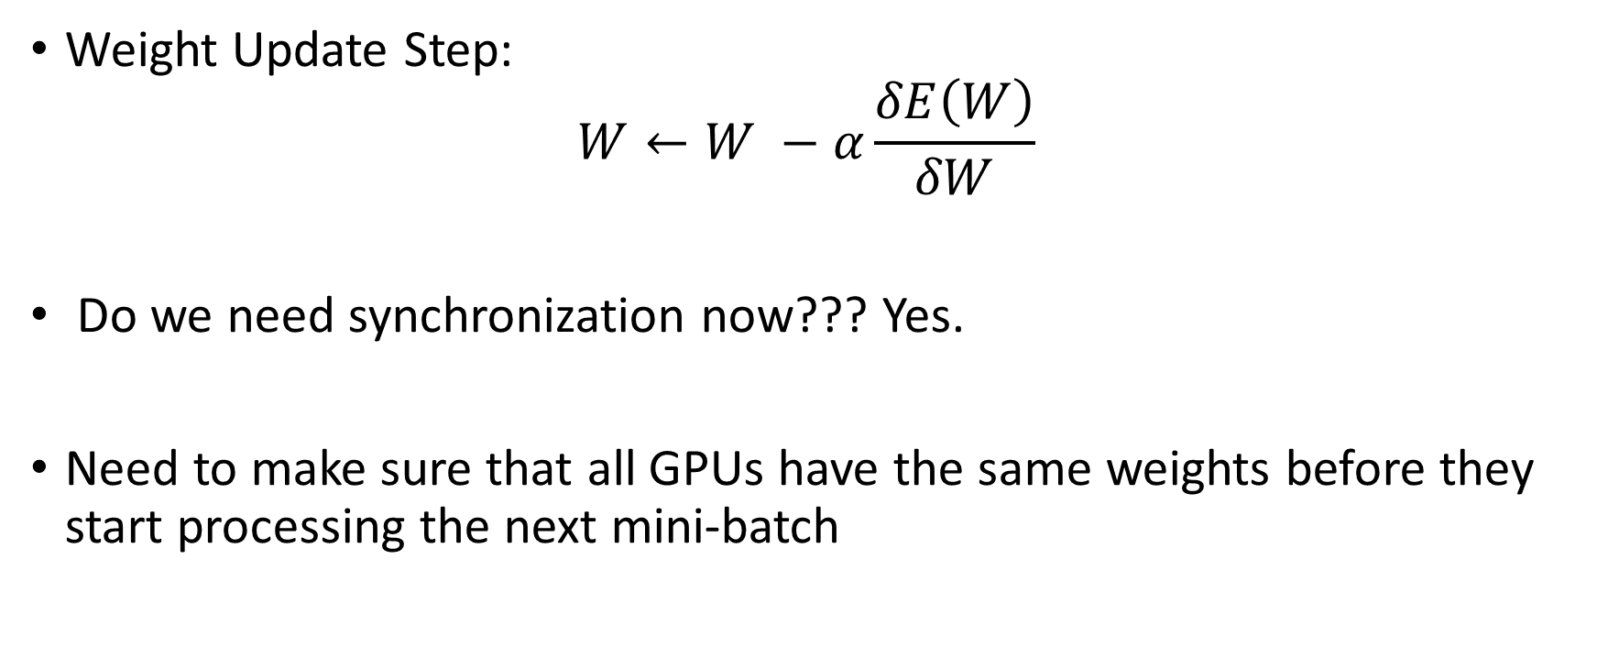
Gradient Update
Weight Update Step:
$$W←W −α\frac{δE\left(W\right)}{δW}$$
Do we need synchronization now??? Yes.
Need to make sure that all GPUs have the same weights before they start processing the next mini-batch

Slide 44
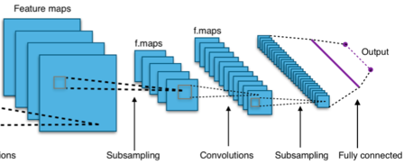

Data Parallel Training of Neural Networks
Synchronization of Gradients
Accelerator
Accelerator
Accelerator
Data
Data
Data
Minibatch $i$

Slide 45
Data Parallel Training of Neural Networks
How do we synchronize?
Model #1: Parameter Server Model
A dedicated server performs the weight updates and distributes the models to all the workers
Resource: Li, Mu, et al. "Scaling distributed machine learning with the parameter server." 11th USENIX Symposium on operating systems design and implementation (OSDI 14). 2014.
Cui, H., Zhang, H., Ganger, G. R., Gibbons, P. B., & Xing, E. P. (2016, April). Geeps: Scalable deep learning on distributed gpus with a gpu-specialized parameter server. In Proceedings of the eleventh european conference on computer systems (pp. 1-16).

Slide 46
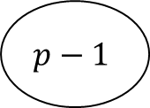

Parameter Server Model
Parameter Server
$$W$$
Data Parallel GPUs
0
1
$$p−1$$

Slide 47



Parameter Server Model
Parameter Server
$$W$$
$$W$$
$$W$$
$$W$$
Data Parallel GPUs
0
1
$$p−1$$

Slide 48
Parameter Server Model
Parameter Server
$$W$$
$$W$$
$$W$$
$$W$$
Data Parallel GPUs
Forward/Backward/
Gradient Calculation
0
1
$$p−1$$

Slide 49



Parameter Server Model
Parameter Server
$$W$$
$$δW^{0}$$
$$δW^{1}$$
$$δW^{p−1}$$
$$W$$
$$W$$
$$W$$
Data Parallel GPUs
0
1
$$p−1$$

Slide 50

Parameter Server Model
Parameter Server
$$∑δW$$
$$W$$
$$δW^{0}$$
$$δW^{1}$$
$$δW^{p−1}$$
$$W$$
$$W$$
$$W$$
Data Parallel GPUs
0
1
$$p−1$$

Slide 51

Parameter Server Model
Parameter Server
$$W′$$
$$W$$
$$W$$
$$W$$
Data Parallel GPUs
0
1
$$p−1$$

Slide 52



Parameter Server Model
Parameter Server
$$W′$$
$$W′$$
$$W′$$
$$W′$$
Data Parallel GPUs
0
1
$$p−1$$

Slide 53
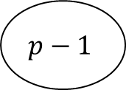
Parameter Server Using Communication Collectives
In each Iteration
#1: Parameter server “sends” the weights to each processor
#2: Forward/Backward/gradient computation in each processor
#3: Each processor sends the gradient back to the parameter server which takes an average of the gradients
#4: Parameter server performs the gradient update step
Repeat
$$W$$
0
1
$$p−1$$

Slide 54
Parameter Server Using Communication Collectives
In each Iteration
#1: Parameter server “sends” the weights to each processor
#2: Forward/Backward/gradient computation in each processor
#3: Each processor sends the gradient back to the parameter server which takes an average of the gradients
#4: Parameter server performs the gradient update step
Repeat
$$W$$
$$W$$
$$W$$
$$W$$
0
1
$$p−1$$

Slide 55
Parameter Server Using Communication Collectives
In each Iteration
#1: MPI_Broadcast(W)
#2: Forward/Backward/gradient computation in each processor
#3: Each processor sends the gradient back to the parameter server which takes an average of the gradients
#4: Parameter server performs the gradient update step
Repeat
$$W$$
$$W$$
$$W$$
$$W$$
0
1
$$p−1$$

Slide 56
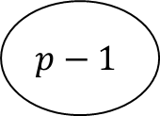

Parameter Server Using Communication Collectives
In each Iteration
#1: MPI_Broadcast(W)
#2: Forward/Backward/gradient computation in each processor
#3: Each processor sends the gradient back to the parameter server which takes an average of the gradients
#4: Parameter server performs the gradient update step
Repeat
$$∑δW$$
$$W$$
$$δW^{0}$$
$$δW^{1}$$
$$δW^{p−1}$$
$$W$$
$$W$$
$$W$$
0
1
$$p−1$$

Slide 57
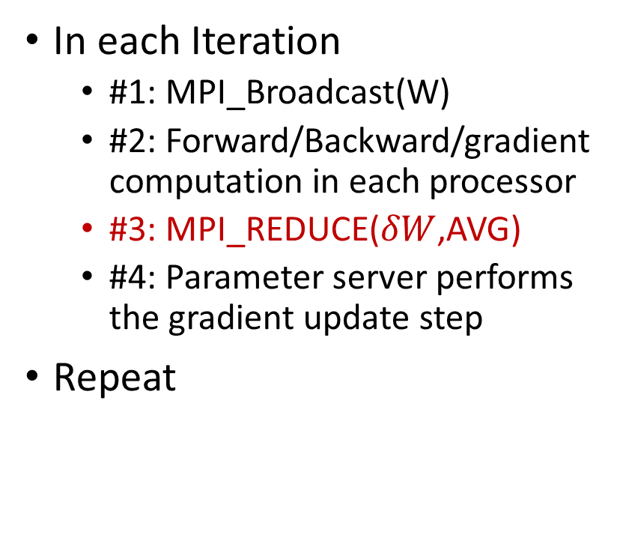
Parameter Server Using Communication Collectives
In each Iteration
#1: MPI_Broadcast(W)
#2: Forward/Backward/gradient computation in each processor
#3: MPI_REDUCE($δW$,AVG)
#4: Parameter server performs the gradient update step
Repeat
$$∑δW$$
$$W$$
$$δW^{0}$$
$$δW^{1}$$
$$δW^{p−1}$$
$$W$$
$$W$$
$$W$$
0
1
$$p−1$$

Slide 58
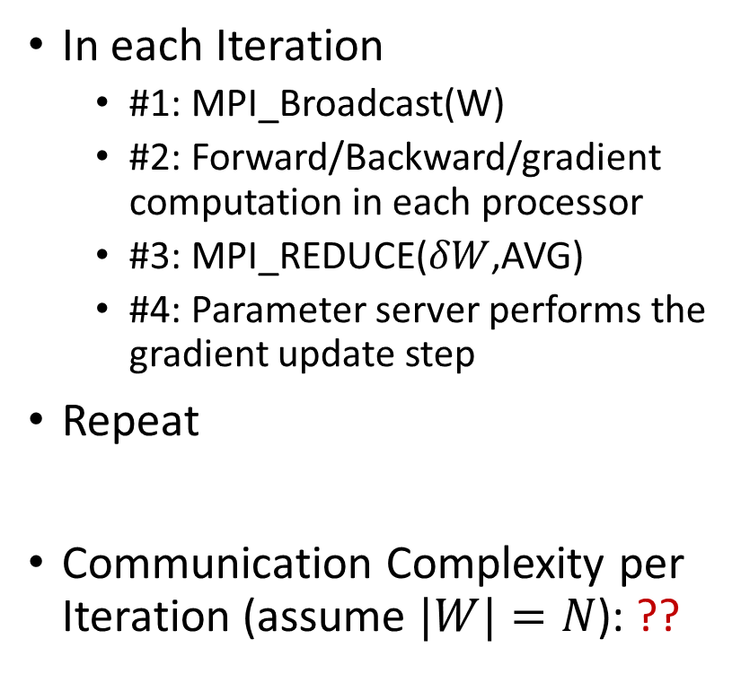
Parameter Server Using Communication Collectives
In each Iteration
#1: MPI_Broadcast(W)
#2: Forward/Backward/gradient computation in each processor
#3: MPI_REDUCE($δW$,AVG)
#4: Parameter server performs the gradient update step
Repeat
Communication Complexity per Iteration (assume $|W|=N$): ??
$$∑δW$$
$$W$$
$$δW^{0}$$
$$δW^{1}$$
$$δW^{p−1}$$
$$W$$
$$W$$
$$W$$
0
1
$$p−1$$

Slide 59

MPI_Broadcast
MPI_Broadcast: $O(t_{w}×log{P)}$
$t_{w}:$ size of data to broadcast
$P$: Number of processors
Algorithm proceeds in $\log{P}$ steps, each step communicates $t_{w}$ amount of data

Slide 60
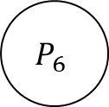
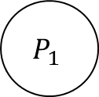
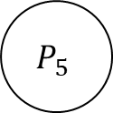
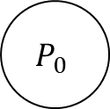
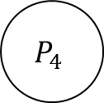
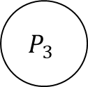

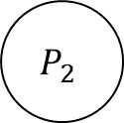
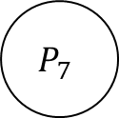
MPI_Reduce
Can you calculate the communication complexity?
1 + 1 + … 1 ($\log{P)}$times = $O(\log{P)}$
$$P_{0}$$
$$P_{1}$$
$$P_{2}$$
$$P_{3}$$
$$P_{4}$$
$$P_{5}$$
$$P_{6}$$
$$P_{7}$$
Step 3

Slide 61
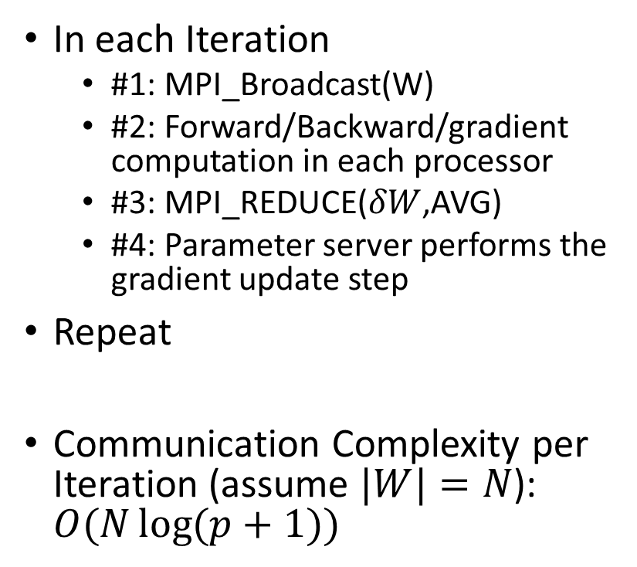
Parameter Server Using Communication Collectives
In each Iteration
#1: MPI_Broadcast(W)
#2: Forward/Backward/gradient computation in each processor
#3: MPI_REDUCE($δW$,AVG)
#4: Parameter server performs the gradient update step
Repeat
Communication Complexity per Iteration (assume $|W|=N$): $O(N\log{(p+1)})$
$$∑δW$$
$$W$$
$$δW^{0}$$
$$δW^{1}$$
$$δW^{p−1}$$
$$W$$
$$W$$
$$W$$
0
1
$$p−1$$

Slide 62
Data Parallel Training of Neural Networks
How do we synchronize?
Model #2: All-reduce based Synchronization
No dedicated parameter server. Each worker calculates the gradients and broadcasts it to all other workers
Each worker aggregates the gradients collected by all other workers and performs the update step
Iandola, F. N., Moskewicz, M. W., Ashraf, K., & Keutzer, K. (2016). Firecaffe: near-linear acceleration of deep neural network training on compute clusters. In Proceedings of the IEEE conference on computer vision and pattern recognition (pp. 2592-2600).

Slide 63
All Reduce Model
In each Iteration:
Forward/Backward Propagation
$$W$$
$$W$$
$$W$$
Data Parallel GPUs
Forward/Backward/
Gradient Calculation
0
1
$$p−1$$

Slide 64
All Reduce Model
In each Iteration:
Forward/Backward Propagation
Gradient Calculation
$$δW^{0}$$
$$δW^{1}$$
$$δW^{p−1}$$
$$W$$
$$W$$
$$W$$
Data Parallel GPUs
0
1
$$p−1$$

Slide 65
All Reduce Model
In each Iteration:
Forward/Backward Propagation
Gradient Calculation
Each processor collects gradients from all the other processors.
$$δW^{0}$$
$$δW^{1}$$
$$δW^{p−1}$$
$$W$$
$$W$$
$$W$$
Data Parallel GPUs
0
1
$$p−1$$
All Reduce Gradients

Slide 66
All Reduce Model
In each Iteration:
Forward/Backward Propagation
Gradient Calculation
Each processor collects gradients from all the other processors.
$$δW^{0}$$
$$δW^{1}$$
$$δW^{p−1}$$
$$W$$
$$W$$
$$W$$
Data Parallel GPUs
0
1
$$p−1$$
All Reduce Gradients

Slide 67

All Reduce Model
In each Iteration:
Forward/Backward Propagation
Gradient Calculation
MPI_ALLREDUCE($δW$,AVG)
$$δW^{0}$$
$$δW^{1}$$
$$δW^{p−1}$$
$$W$$
$$W$$
$$W$$
Data Parallel GPUs
0
1
$$p−1$$
All Reduce Gradients

Slide 68
MPI_AllReduce
MPI_AllReduce(inbuf, resultbuf, size)
Same as MPI_Reduce() but stores the results in all the processors
Equivalent to:
MPI_Reduce(inbuf, ibsize, resultbuf, rbsize, Aggr_op, root)
MPI_Broadcast(resultbuf, rbsize, root )

Slide 69
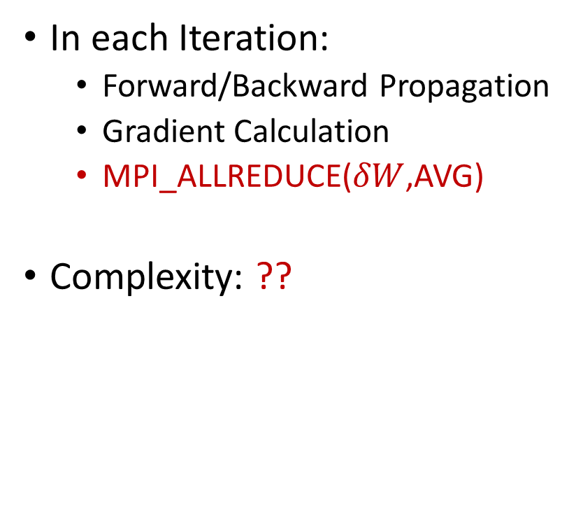
All Reduce Model
In each Iteration:
Forward/Backward Propagation
Gradient Calculation
MPI_ALLREDUCE($δW$,AVG)
Complexity: ??
$$δW^{0}$$
$$δW^{1}$$
$$δW^{p−1}$$
$$W$$
$$W$$
$$W$$
Data Parallel GPUs
0
1
$$p−1$$
All Reduce Gradients

Slide 70
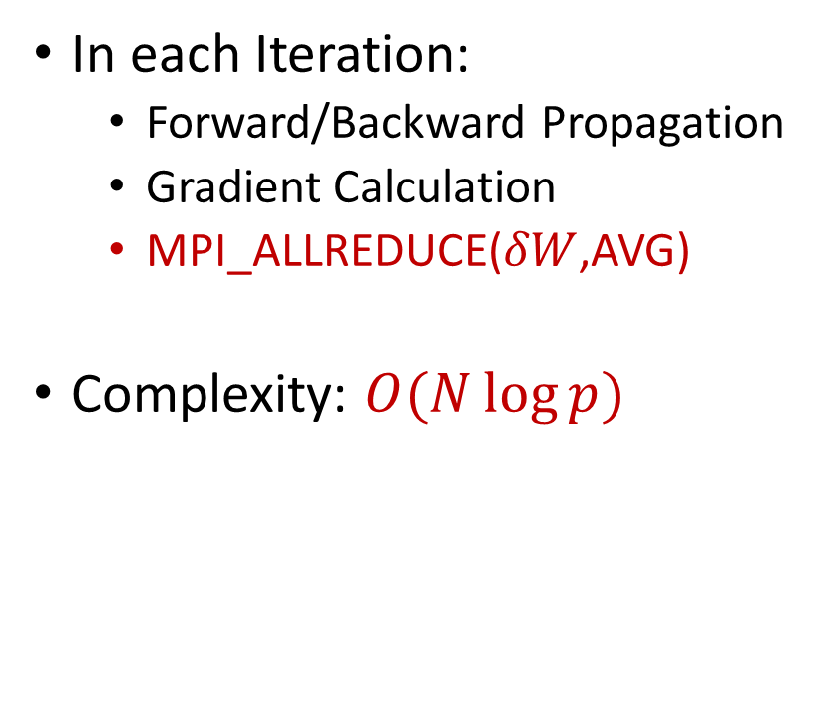
All Reduce Model
In each Iteration:
Forward/Backward Propagation
Gradient Calculation
MPI_ALLREDUCE($δW$,AVG)
Complexity: $O(N\log{p})$
$$δW^{0}$$
$$δW^{1}$$
$$δW^{p−1}$$
$$W$$
$$W$$
$$W$$
Data Parallel GPUs
0
1
$$p−1$$
All Reduce Gradients

Slide 71
3D Parallelism
In practice, all three parallelisms are combined
Data + Pipeline + Tensor = 3D parallelism
DeepSpeed: https://github.com/microsoft/DeepSpeed/tree/master?tab=readme-ov-file

Slide 72
Next Class
11/25 Final exam

Slide 73
Thank You
Questions?
Email: sanmukh.kuppannagari@case.edu

